Slide 1
Beyond the Classroom:
Extending Learning though Classroom Websites

Slide 2
Finding Your Platform: To Pay or not to pay?
The Freebies Money Required
www.jimdo.com www.godaddy.com
www.moonfruit.com www.squarespace.com
www.weebly.com
www.doodlekit.com
www.wordpress.com
Notes:
Freebies- All drop and drag software. No skills coding required. Can purchase upgrades for each platforms
Money required- require at least a start-up fee or monthly to yearly subscription
Find was is best for you and your classroom needs
Find something that fits your needs

Slide 3
Website Construction: The basics
Make your site user friendly
Organize it by grade level or ensemble
Use an easy to remember domain
Notes:
Attractive, but easy and intuitive to navigate
Label it so substitutes would be able to use it so you won’t miss a day from teaching
No one wants to type www.Supercalifragilisticexpialidocious.com

Slide 4
Website Content: The Basics
Curriculum
Daily schedule and contact information
Parent Communication
Upcoming performances
Private lesson teachers
Notes:
Get the word out about your site. Paper communication music have web address on it, email signature, student incentives to visit site
Put class/ensemble/building schedule on your site. Parents need to know where you are if they want to contact you
Concert information, instrument info (order forms, vendors,

Slide 5
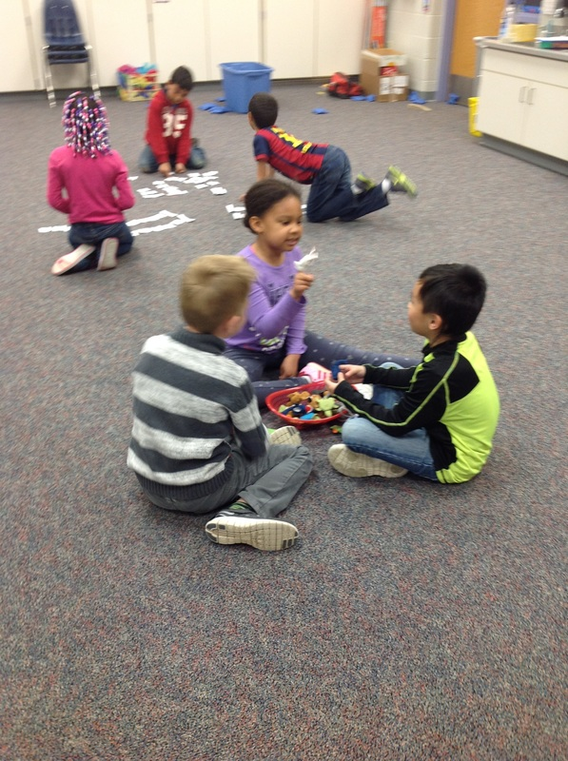
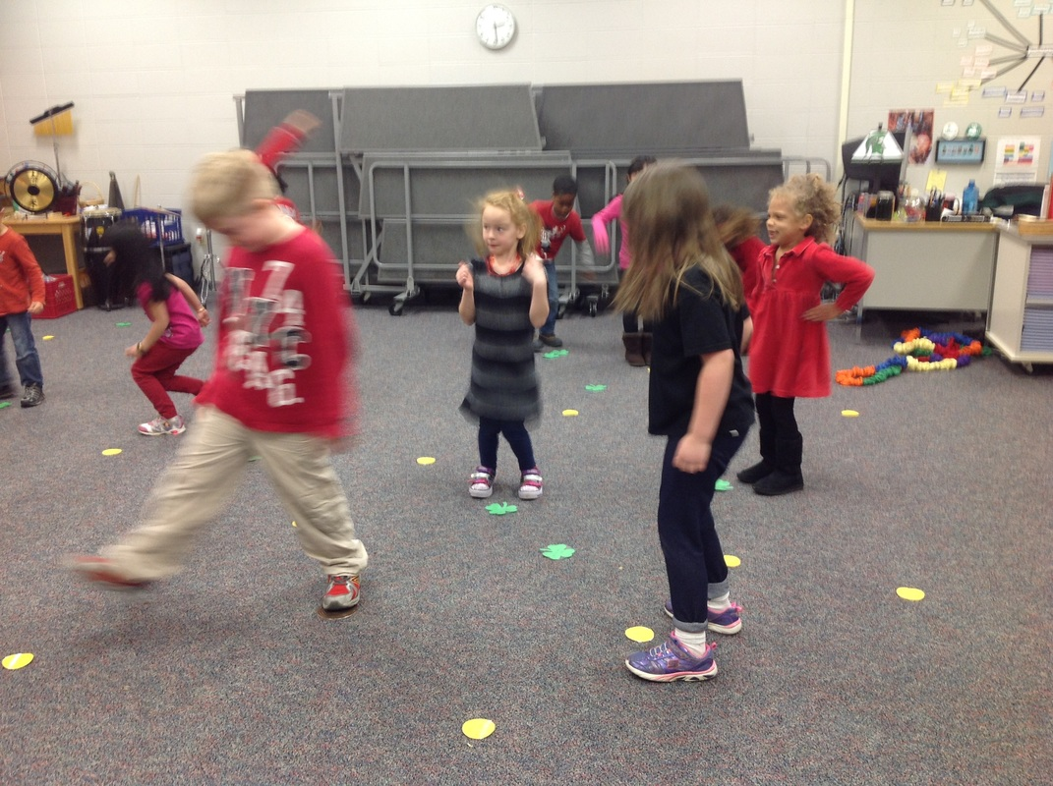
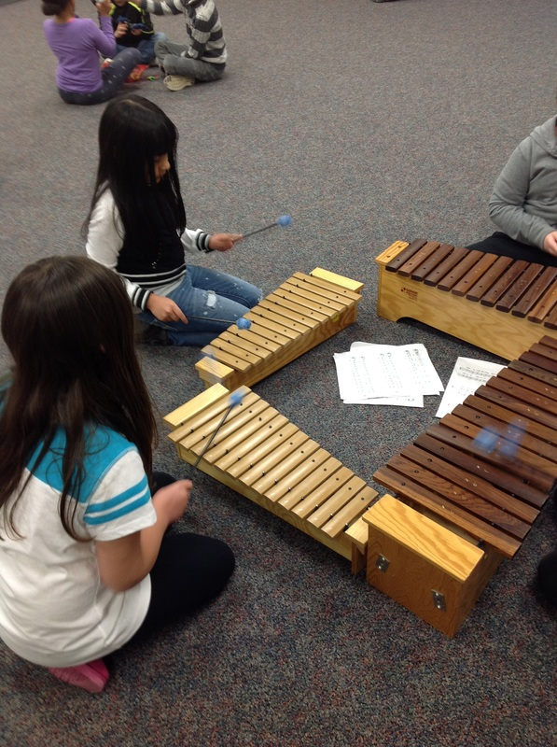
Website Content: What happens in Music class
Use pictures, videos, and audio
Start a blog
Feature a grade level, ensemble, or a section
Notes:
Make sure all students have signed the photo release form
We all have camera phones or recording capabilities

Slide 6
Keep them coming back
Composer of the Month
Instrument of the Month
Entire recorder/ukulele curriculum
Past performances
Add “extra material”
Enable comments
Notes:
Create monthly games were students can send in their comments for prizes
Record yourself doing recorder or ukulele songs for mini lessons. Allows students who are ready to move on extra songs or activities to complete
Extra materials ranging from rhythm/tonal patterns, pop songs on instruments, etudes through voice threads

Slide 7
Adding Resources
Quizlet
Noteflight
YouTube
VoiceThreads
AudioBoom

