Slide 1
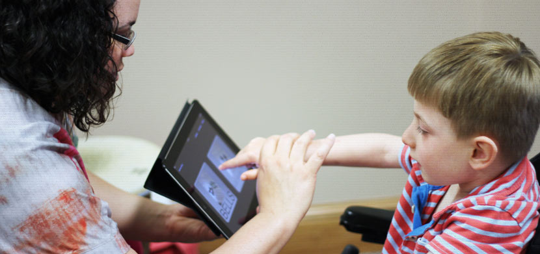
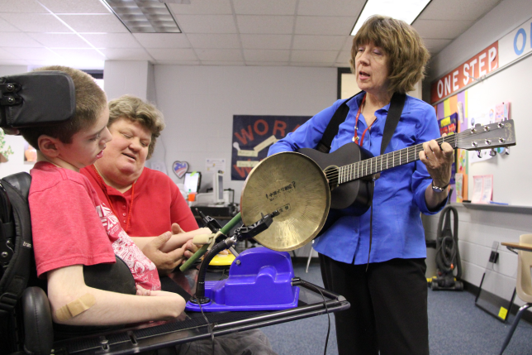
Music for Special Learners
How prepared are we?

Slide 2
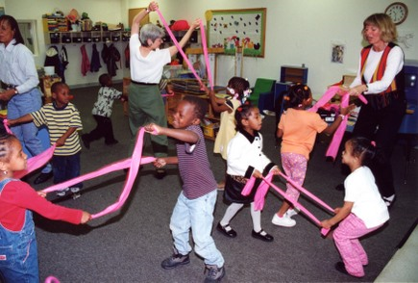
Special Education Courses
Colwell & Thompson (2000)
74% offered a special education course at all
21% offered
Music-specific
College of
Education

Slide 3
Music-Specific SPED Classes
Salvador (2010)
30% require, 40% offer
60% “integrate”
Why so low?
Heller 1994,
27% faculty
SPED training

Slide 4
How do we pick up the slack?
Trial and error…
Special Education teachers
Other music educators
Music Educators Journal
Conference sessions
Make addressing the needs of special learners a PRIORITY, not an AFTERTHOUGHT

Slide 5
Bibliography
Colwell, C. M., & Thompson, L. K. (2000). “Inclusion” of information on mainstreaming in undergraduate music education curricula. Journal of Music Therapy, 37(3), 205–221.
Salvador, K.(2010). Who isn’t a special learner? A survey of how music teacher education programs prepare future educators to work with exceptional populations. Journal of Music Teacher Education, 20(1). (27-38).
Heller, L. (1994). Undergraduate music teacher preparation for mainstreaming: A survey of music education teacher training institutions in the Great Lakes region of the United States. Unpublished doctoral dissertation, Michigan State University, East Lansing.

