Slide 1
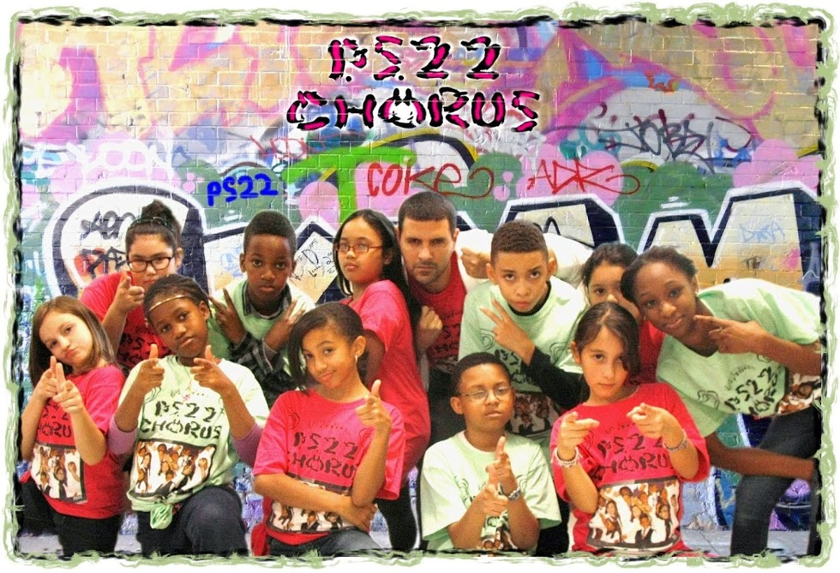
Pop Music in the classroom?...
The haters gonna hate, hate, hate, hate, hate…

Slide 2
Good morning!
Ready to sing?
Example 1
Example 2
Which did you prefer? Honestly?
How about these kids?
Too much caution in approaching pop music
Instructors advise against it, teachers avoid using it.
Is it because of the Lojeski arrangements?
Why? It keeps kids attention and keeps class cool and relevant
Do kids still say “cool”?

Slide 3
No, Bieber isn’t Brahms
Perry isn’t Paganini and Swift isn’t Shostakovich
Still has inherent musical value
Do they have a melody?
Harmonic structure?
Instrumentation?
It IS music, and it means something to your students
Use it as a bridge between new and old
How many of you would rather listen to Vivaldi than Bruno Mars?
Remember who you are teaching as well
Are all of your students going to grow up to be professional composers?
They will all be musicians
And in their own right, music educators and advocates

Slide 4
Adaptation and Results
Elementary perspective
Year 1 and year 2: Recorder Karate
Video
MS Choir perspective
Incorporates democracy
Tests my musical knowledge
Choir numbers have increased
Parent support

Slide 5
A Few Activities I have used
Elementary
Recorder Karate
Rock’N’Roll composition
Harmonization activities
Shouldice (2011) gives examples with boomwhackers
Middle School Choir
Harmonization/improvisation activities
Ready to sing again? (I-IV-V-I for Wavin’ Flag)
Parody Projects
Introduce new instruments
Or make opportunities for those who play others
Melodic or Rhythmic Dictation
Or figure out a melody in solfege

Slide 6
Your Turn
Keep an open mind
Keep it simple, keep it creative
Arrange your own music!
Many arrangements sound nothing like the song itself
You don’t have to let it take over!
Use it to supplement material, not replace it
Use it as a bridge to open students to the whole world of music
And always, check it first for content and context

