Slide 1
Auditioned and Non-Auditioned Ensembles
MUS 863

Slide 2
The Auditioned Ensemble
PROs
Option of creating a balanced ensemble
Separates groups by ability
Notes:
https://etd.ohiolink.edu/!etd.send_file?accession=bgsu1151080979&disposition=inline

Slide 3
Auditioned Ensemble
CONS
Separation by ability could create an unwanted hierarchy
Students attribute success to musical ability, and not effort

Slide 4
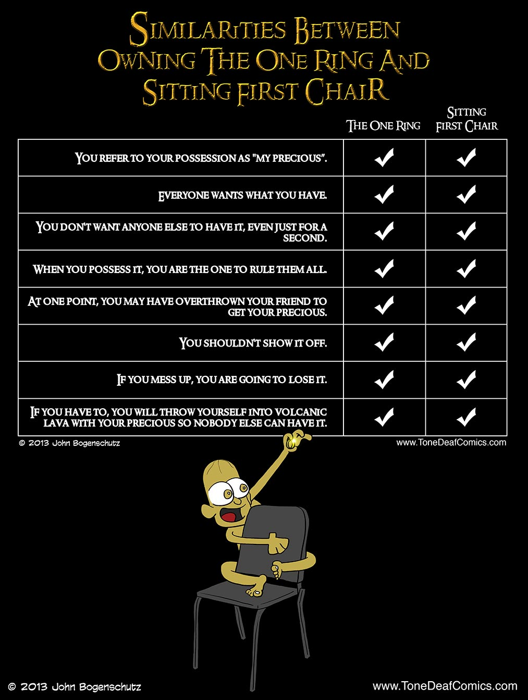

Slide 5
Motivation….
Motivation
Achievement
Self-Esteem

Slide 6
Alternatives
Create ensembles based on grade level
Mix ensembles so the all have balanced sounds and similar abilities
Audition ensemble, but use rotating seating

Slide 7
Resources
Daniel, Justine R. https://etd.ohiolink.edu/!etd.send_file?accession=bgsu1151080979&disposition=inline

