Slide 1
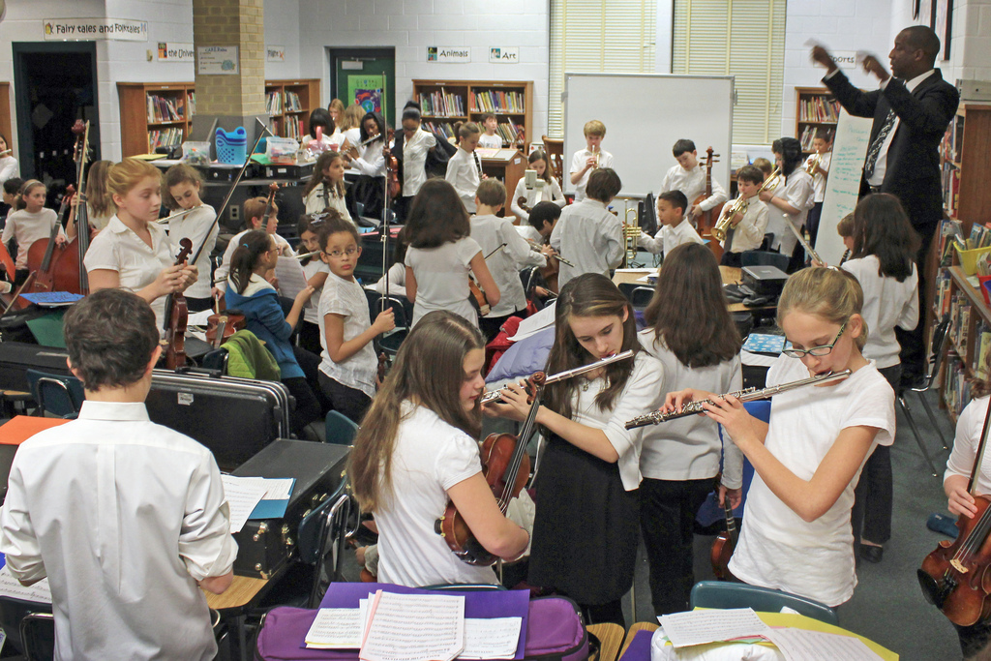
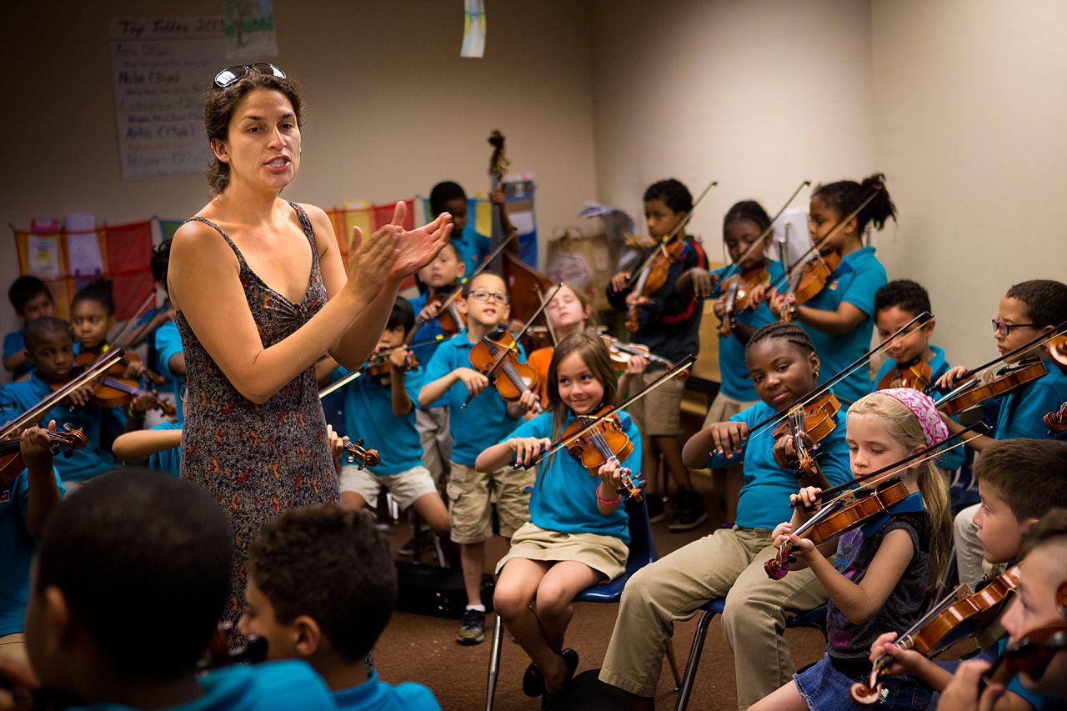
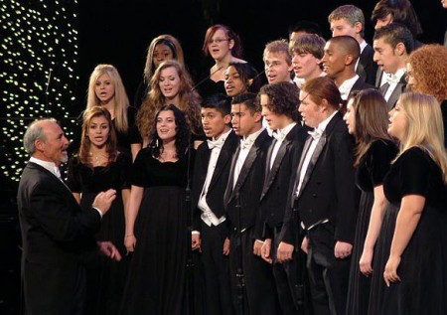
SCHOOL MUSIC

Slide 2
exclusive
limiting
unAmerican
authoritarian
out-of-touch
narrow
hierarchical
antiquated
rigid
competitive
autocratic
elitist
accessible
flexible
sustainable
open
relevant
innovative
individualized
creative
diverse
digital
participatory

Slide 3
“school music should not be its own musical practice”
“…the pluralistic world of music that exists outside the schoolhouse doors…has challenged the hegemony that the conservatory has bequeathed to school music.”
Regelski 2008
“…the literature chosen should not be the curriculum!”

Slide 4
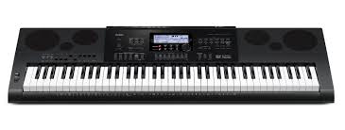
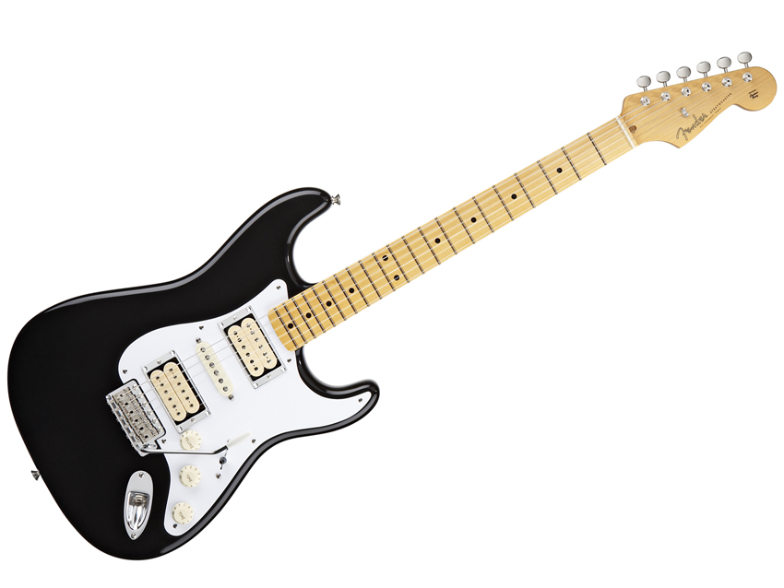
“The music made in schools, largely based on classical, folk, and sometimes jazz traditions, represents a small and shrinking slice of the musical pie.”
Kratus (2007)
“One wonders whether our profession’s resistance to change is a direct result of the limitations in the musicianship we have been taught.”

Slide 5
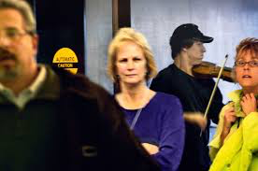
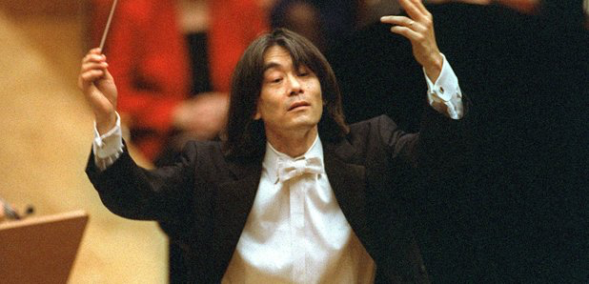
Classical music is dead.

Slide 6
Informal music learning
pop music
improvisation
What should we do???
technology
karaoke

Slide 7
No more music in schools
.

Slide 8
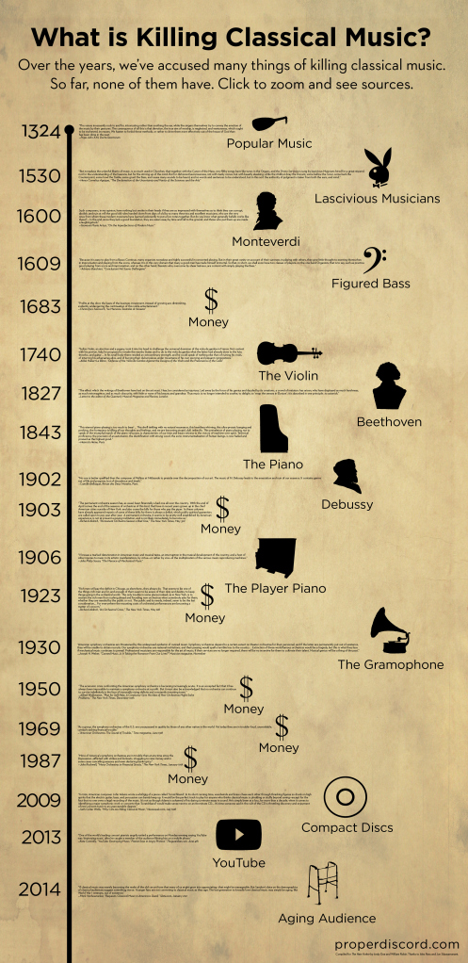
Andy Doe

Slide 9
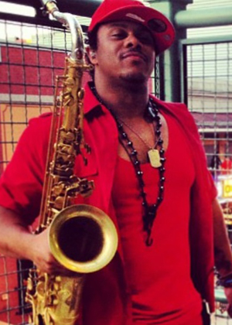

Slide 10
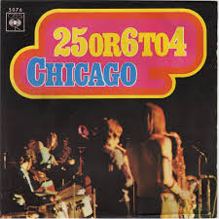
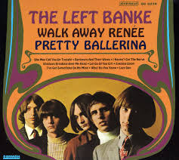
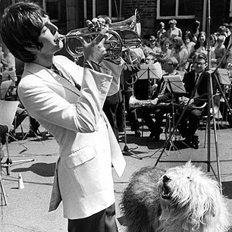
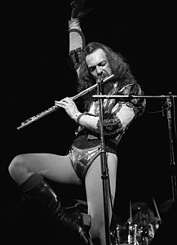
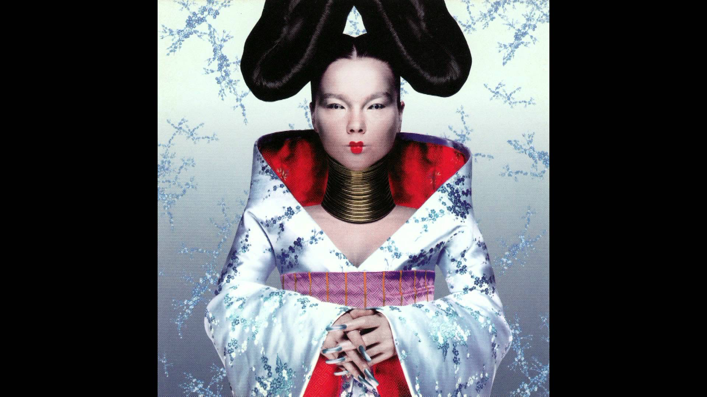
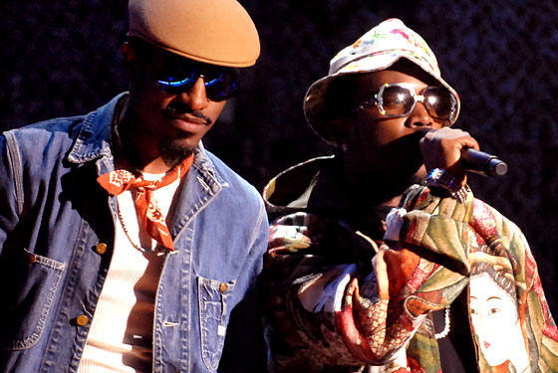

Slide 11
Access
Comprehensive Musicianship
Individual empowerment
Collaborative approaches
Broader repertoire
Miksza (2013)

Slide 12
Praxial, pragmatic
Students deserve to be able to take part fruitfully in the musical practices of society
(a) at all
(b) in new ways
(c) To a degree that would not have been the case without school music
Action ideal
Break 100
Inconclusions

Slide 13
Colwell (1995)
Kratus (2007)
“The essential element in a strong music program is an enthusiastic, able teacher.”
“I also never would’ve believed that seventh graders would find opera ‘cool’.”
Mavens

Slide 14
Colwell, R. J. (1995). Voluntary national standards and teacher education. Bulletin of the Council for Research in Music Education, 20-31.
Freedman, B. (2013). Teaching Music Through Composition: A Curriculum Using Technology. Oxford University Press.
Hickey, M. (2009). Can improvisation be ‘taught’?: A call for free improvisation in our schools. International Journal of Music Education, 27(4), 285-299.
Kratus, J. (2007). Centennial series: Music education at the tipping point. Music Educators Journal, 42-48.
Miksza, P. (2013). The Future of Music Education Continuing the Dialogue about Curricular Reform. Music Educators Journal, 99(4), 45-50.
Regelski, T. (2008). Music education for a changing society. Diskussion Musikpädagogik, 38, 34-42.
Thibeault, M. D. (2011). A Critical Pragmatic Approach to Technology in Music Education: Response to John Kratus’“Transitioning to Music Education 3.0”.
Robin, William (2014). The Fat Lady is Still Singing. The New Yorker Retrieved from http://www.newyorker.com/culture/culture-desk/the-fat-lady-is-still-singing

