Slide 1
Assessment, Part 2
I’m on board, now what?

Slide 2
Us vs. Them
New teachers vs. seasoned teachers
Classroom subjects vs. special subjects
Administration vs. teachers

Slide 3
Let’s change the climate
Instead of fighting or simply “playing the game,” let’s use valid and reliable assessment tools that further our profession and our teaching!
See Kristen’s presentation from Monday for even more information ☺

Slide 4
“I’m on board, now what?”
MAEIA project is in action now in the State of Michigan and has been for a few years.

Slide 5
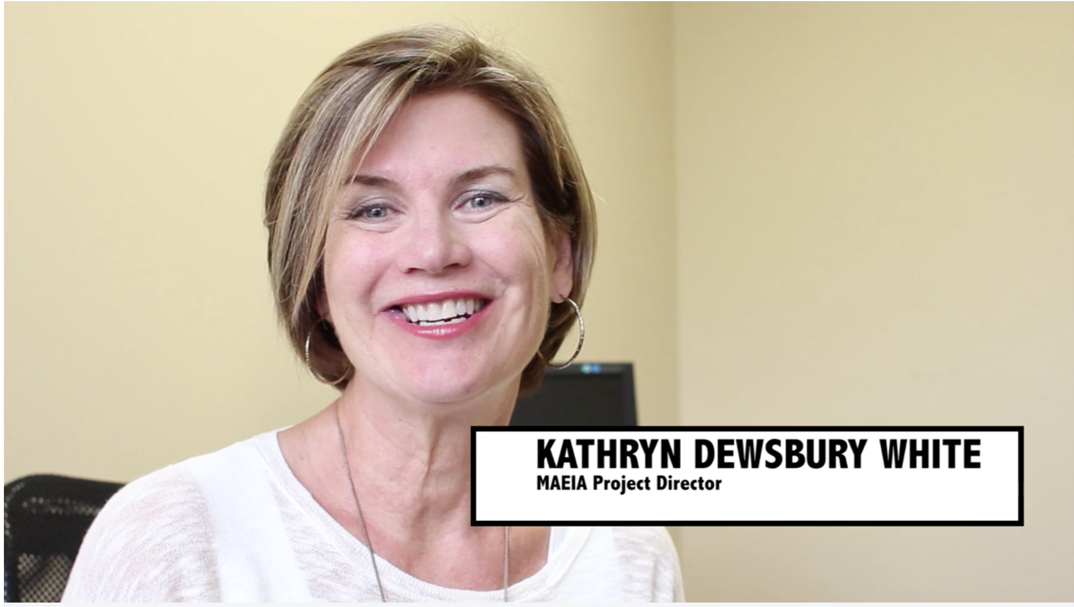
Let’s explore…
Video introduction- https://vimeo.com/107854249
Website- http://www.michiganassessmentconsortium.org/maeia

Slide 6
How can I get involved?
K-8 field testing: 2015-2016 school year
Get a sneak peek at future assessments and provide feedback to make sure that they are kid and teacher friendly!
Stop fighting and “playing the game,” help change the system from within!

