Slide 1
MUSIC BOOSTER CLUBS:
Purpose, advantages, and starting one
A Lightning talk by
James D. Jones

Slide 2
Music booster clubs
WHAT ARE THEY?
A group of concerned individuals working together for the betterment of a Music Program
In other words……..Parents and other Adults who help

Slide 3
WHY Have One?
Building an advocacy base for your students
Building a support system for your program
Building relationships with students and parents
So many things to do, so little time, and only one of you!

Slide 4
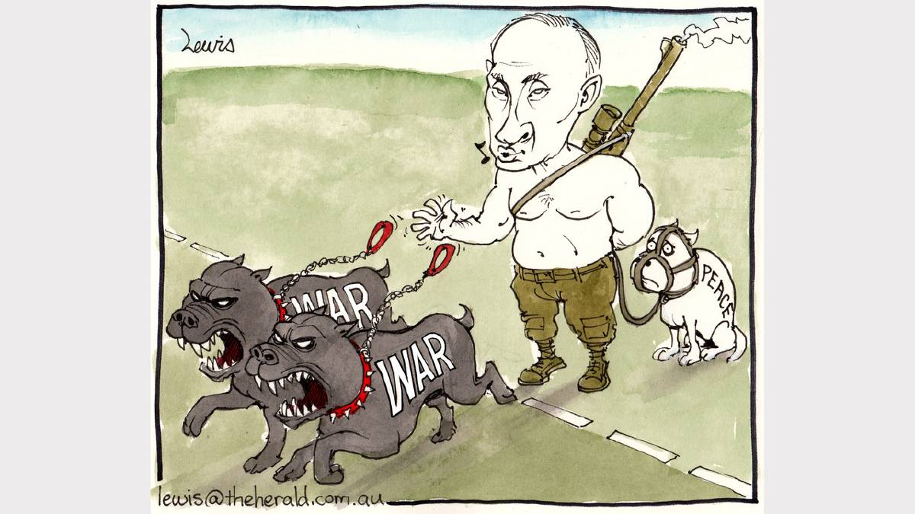
Here’s a story………..

Slide 5
How To Start….
Draft a Constitution
You don’t have to re-invent the wheel, find one online and retrofit it to your needs and specifications
2. Have a meeting
Outline your goals and objectives
Nominate and Select Officers (according to your Constitution)
Have food at the meeting
(If you feed them, they will come)

Slide 6
How to start (continued)…
3. Set up committees
Uniform
Chaperone
Public Relations
Audio/Visual
Fundraising
And many, many, more…..

Slide 7
How To Start (Continued)
4. Give a questionnaire
Show parents where they can help
Some may have special talents/skills or have a music background
5. Apply for a 501 (c) (3)
Non-profit organization
Tax exempt status
Allows you to accept large donations from corporations

Slide 8
Things to watch for…..
Empower your parents, but don’t relinquish your authority
Power tends to corrupt and absolute power corrupts absolutely. (Lord Acton)
Always remember, the onus of responsibility falls squarely on your shoulders.
IT’S YOUR PROGRAM……..YOU HAVE THE FINAL SAY!

Slide 9
If all goes well……….

Slide 10
THANK YOU For Your time and attention

